Slide 1
Category review: Chips
June 2020
Retail Analytics
Brand note: If client logo is not required, use alternate title page layout right click slide thumbnail > Layout > Title

Slide 2
Notes:
To view Privacy video explaining how important data privacy is to Quantium, please click here: https://www.youtube.com/watch?v=Zq1QDAkoRzU
or here Q:\Company Reference\Brand & Design\Brand videos\Q Privacy.mp4
At Quantium, we believe that data is the behavioural footprint of humanity and that it has to be treated with the utmost care and responsibility.
Histories, attitudes, indeed lives are stored within it in ways that aren’t always apparent – and that’s what makes its potential so powerful.
To work with it responsibly, sensitively, we set ourselves the highest data privacy protection and governance standards.
We have spent 17 years perfecting privacy-by-design and secure-by-design principles. Central to this is not holding any personally identifiable information about people –
we neither receive it, and put the necessary protections in place to be unable to decipher it.
Every aspect of handling data is safeguarded: from its de-identification, to its encryption – data security is paramount and of the highest grade.
We pride ourselves on gaining the trust of iconic organisations around the world through years of securely working with their data,
and in turn the trust that builds with their stakeholders.

Slide 3
Executive summary
01
Task 1
Comparison of Chip sales overtime. From 2018 t0 2019.
Impact of customer affluence and spending habits.
Customer life stage and affluence impact on spending habits
02
Task 2
Overall the stores outperformed control stores in every category during the trial period
The trial stores do show a leveling out of performance in the third month.
Tow out of the three stores are showing higher every category to control stores at the end

Slide 4
01
Category

Slide 5
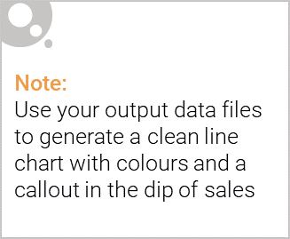
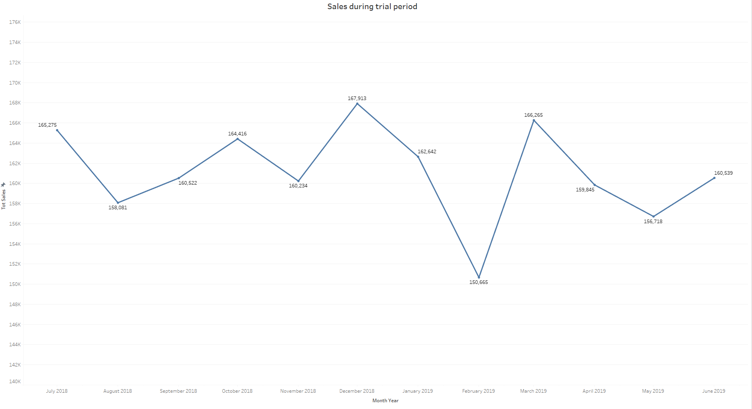
Total sales trend for the past year
Total sales for the year 2019 has decreased from 2018. Showing slight improvement in the month of June.

Slide 6

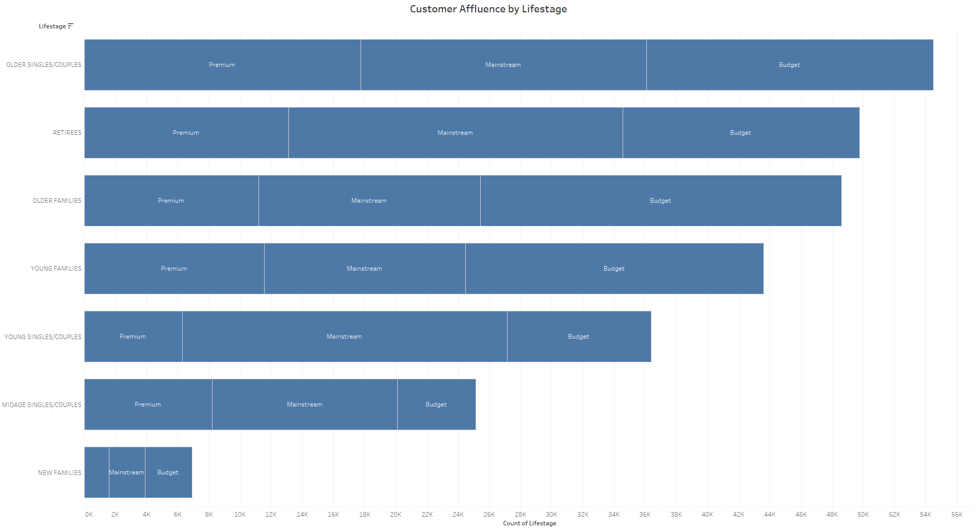
Customer affluence and its effect on customer baying
As we can see on the graph below Mainstream customers made the most chip purchases with budget customer in second. It does not seem affluence has a large impact on chip sales as one would expect.

Slide 7
02
Trial store performance

Slide 8
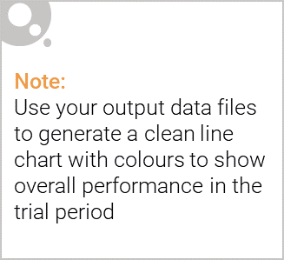
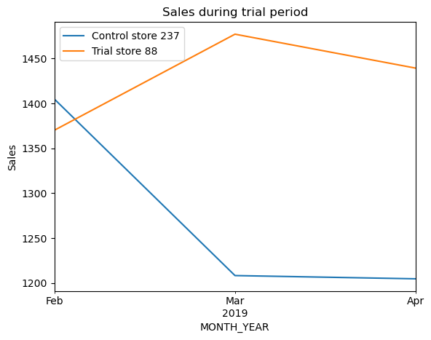
Trial stores vs Control stores
The data shows that trial stores have increased sales from February ends with a slight decline in April.
The control stores declined from February and since levelled out March into April.

Slide 9
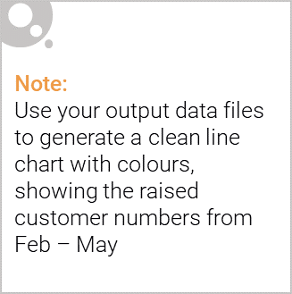
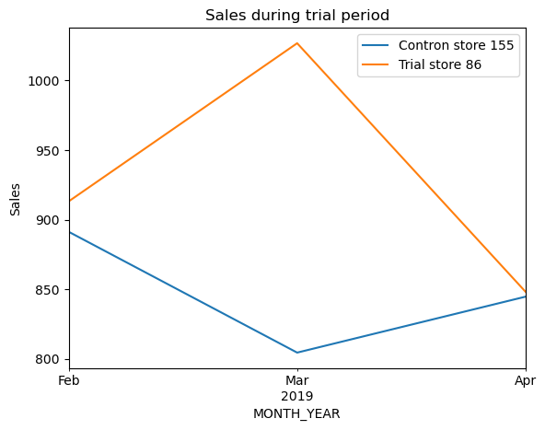
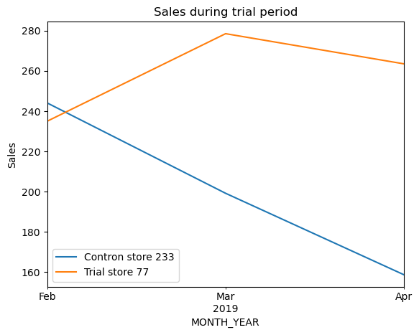
Trial stores vs Control stores: Transactions
The data shows that the trial stores have increased sales transactions from February and end with a slight decline in April.
The control stores declined from February and since levelled out March into April. While control store 233 continued a decline.

Slide 10
Recommendations:
Tow of the three trial stores are outperforming their control stores.
One store continued to increased after the trial period. Showing a possible change in customer purchase behaviour in store 77.
Our recommendation would be to convert the stores into a new layout. After 6 months
I would consider another Analysis to see the impact the new layout has across a large sample
of stores and how the sales volume is trending overtime.

